Slide 1


Scraping Alpha⍺
Stock prediction through sentiment analysis techniques
AARSH SACHDEVA
Scraping Alpha⍺

Slide 2
Table of Contents
Seeking Alpha Overview
Sentiment Analysis
Naïve Bayes Theorem
Implementation Process
Evaluation Metrics
Training Set Sensitivity Analysis
Test Set Results
Next Steps
Scraping Alpha⍺

Slide 3
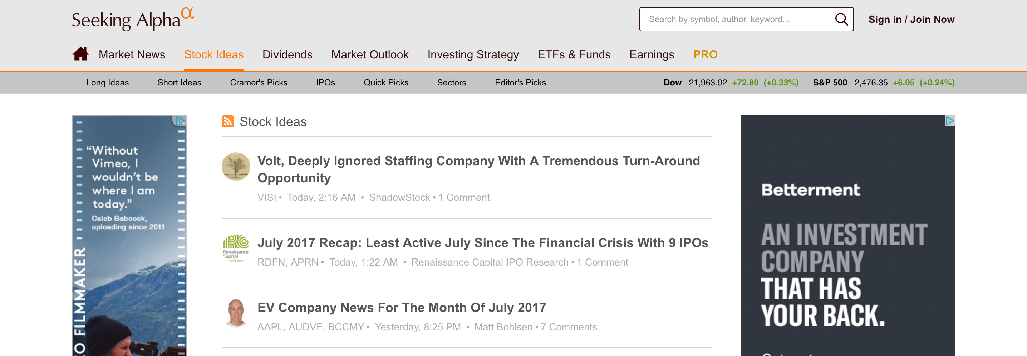
Seeking Alpha
Seeking Alpha is crowd-sourced content service website for financial markets. Published articles and research provide financial commentary and analysis on a wide-variety of topics in the world of finance, such as publicly traded equities, credit, ETFs, investment strategies, company news, and current events.
I chose to scrape stock idea articles
Scraping Alpha⍺

Slide 4
Sentiment Analysis
Scraping Alpha⍺

Slide 5
Sentiment Classification
Typical sentiment analysis attempts to predict the writer’s orientation towards an object by analyzing the words they use to describe it.
For example:
Positive Sentiment: “…zany characters and richly applied satire, and some great plot twists”
Negative Sentiment: “It was pathetic. The worst part about it was the boxing scenes…”
The goal of this analysis is to assign an article a classification of “high” or ”low” that indicates whether the article is successful at predicting positive returns.
Scraping Alpha⍺

Slide 6
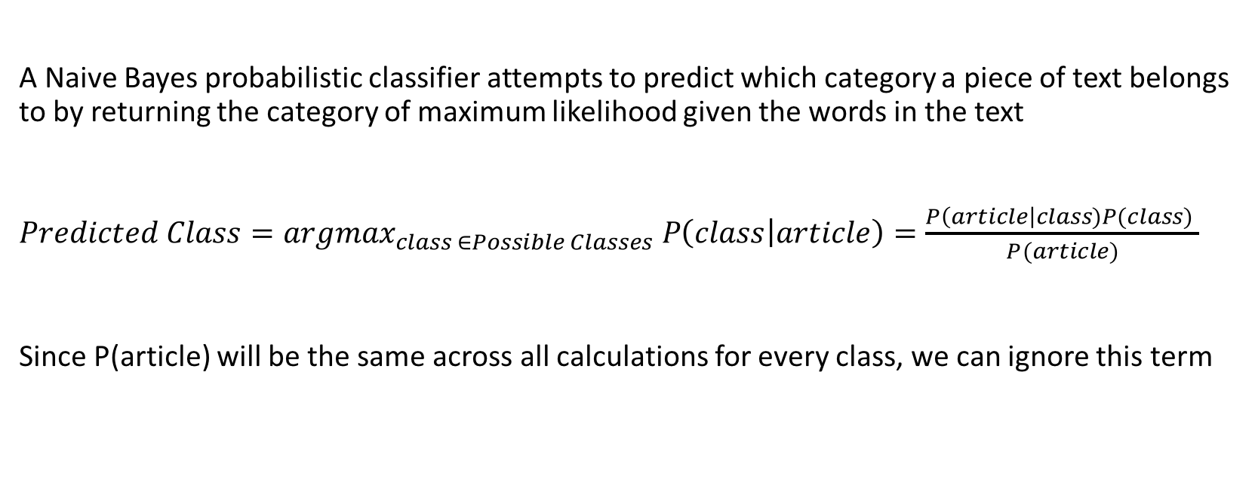
Naïve Bayes Theorem
A Naive Bayes probabilistic classifier attempts to predict which category a piece of text belongs to by returning the category of maximum likelihood given the words in the text
$Predicted Class={argmax}_{class ∈Possible Classes} P\left(class | article\right)=\frac{P\left(article\right|class)P(class) }{P(article)}$
Since P(article) will be the same across all calculations for every class, we can ignore this term
Scraping Alpha⍺

Slide 7
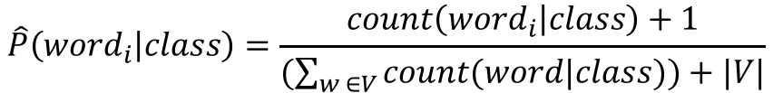
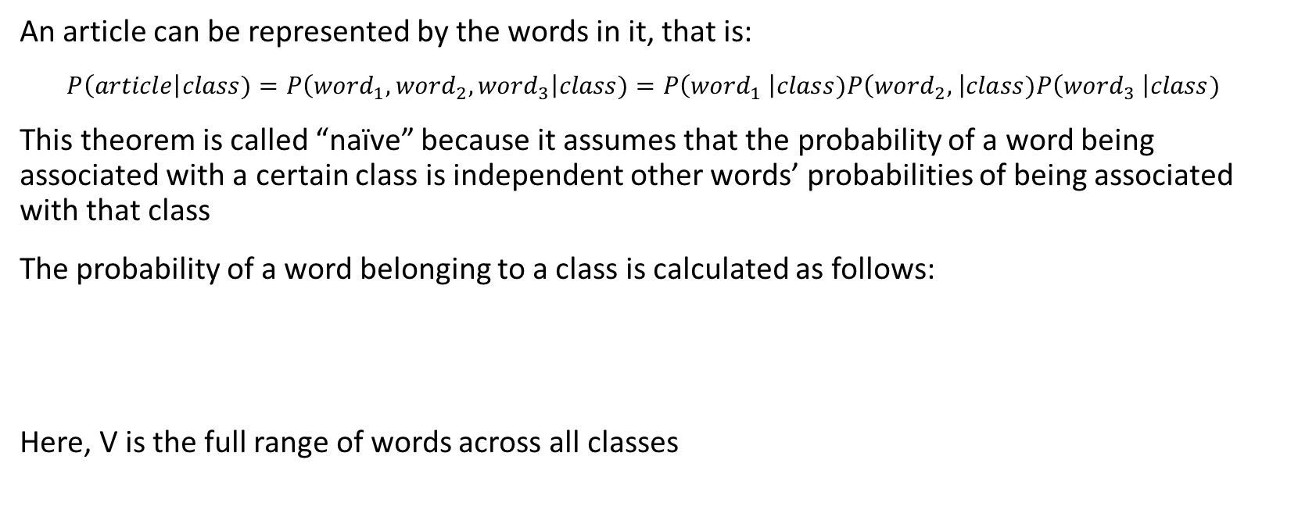
Naïve Bayes Theorem
An article can be represented by the words in it, that is:
$P\left(article\right|class)=P\left({word}_{1},{word}_{2},{word}_{3}\right|class)=P\left({word}_{1} \right|class)P\left({word}_{2}, \right|class)P\left({word}_{3} \right|class)$
This theorem is called “naïve” because it assumes that the probability of a word being associated with a certain class is independent other words’ probabilities of being associated with that class
The probability of a word belonging to a class is calculated as follows:
Here, V is the full range of words across all classes
$$\hat{P}\left({word}_{i} | class\right)=\frac{count\left({word}_{i} | class\right)+1}{(\sum_{w ∈V}{count(word|class))+|V|}}$$
Scraping Alpha⍺

Slide 8
Naïve Bayes Theorem: Example
The following sentences constitute our training data and have already been classified:
Negative: “just plain boring”
Negative: “entirely predictable and lacks energy”
Negative: “no surprises and very few laughs”
Positive: “very powerful”
Positive: ”the most fun film of the summer”
Naïve Bayes Theorem will be used to classify this sentence that constitutes our testing data:
“predictable with no fun”
Scraping Alpha⍺

Slide 9
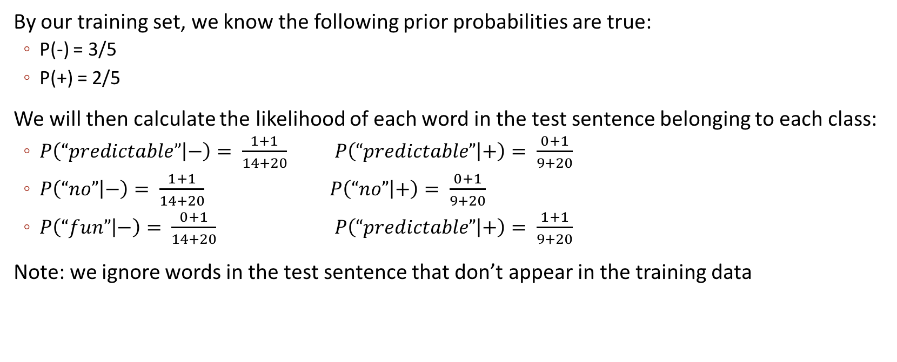
Naïve Bayes Theorem: Example
By our training set, we know the following prior probabilities are true:
P(-) = 3/5
P(+) = 2/5
We will then calculate the likelihood of each word in the test sentence belonging to each class:
$P\left(“predictable” | −\right)= \frac{1+1}{14+20}$ $P\left(“predictable” | +\right)= \frac{0+1}{9+20}$
$P\left(“no” | −\right)= \frac{1+1}{14+20}$ $P\left(“no” | +\right)= \frac{0+1}{9+20}$
$P\left(“fun” | −\right)= \frac{0+1}{14+20}$ $P\left(“predictable” | +\right)= \frac{1+1}{9+20}$
Note: we ignore words in the test sentence that don’t appear in the training data
Scraping Alpha⍺

Slide 10
Implementation
Scraping Alpha⍺

Slide 11
Implementation Process
Scrape Seeking Alpha for long/short idea articles
Chunk off a specific time frame of articles for the training set and a specific frame for the test set. In this analysis, a three year period between 08/2012 and 08/2015 was used for training and a two year period between 08/2015 and 08/2017 was used for testing
Sample a certain number of articles within each time frame. In this analysis, 500 articles were used in training and 200 were used in testing.
In the training set, calculate returns of the associated stocks for a specified holding period. Then assign a cutoff return that will be used to categorize the article as either “high” or ”low”
Optimize the holding period and cutoff point within the training set to achieve best predictive performance
Use these parameters in the model to predict the category an article will fall into in the test set. Then calculate actual realized returns and compare the results
Scraping Alpha⍺

Slide 12
Evaluation Metrics
Scraping Alpha⍺

Slide 13
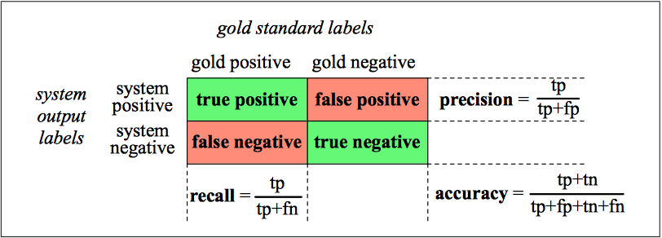
Evaluation: Precision, Recall, F-Measure
$F_{1}−Measure: \frac{2∗Precision∗Recall}{Precision+Recall}$
Scraping Alpha⍺

Slide 14
Training Set Sensitivity Analysis
This is a problem. Means we’re predicting so many positives, we’re not being selective
F₁-Measure | 0% | 3% | 5%
10-Day | 1.0 | 0.386 | 0.275
20-Day | 1.0 | 0.648 | 0.452
60-Day | 1.0 | 0.897 | 0.536
Accuracy | 0% | 3% | 5%
10-Day | 1.0 | 0.255 | 0.160
20-Day | 1.0 | 0.606 | 0.330
60-Day | 1.0 | 0.904 | 0.447
Precision | 0% | 3% | 5%
10-Day | 1.0 | 0.239 | 0.160
20-Day | 1.0 | 0.479 | 0.292
60-Day | 1.0 | 0.813 | 0.366
Recall | 0% | 3% | 5%
10-Day | 1.0 | 1.0 | 1.0
20-Day | 1.0 | 1.0 | 1.0
60-Day | 1.0 | 1.0 | 1.0
Scraping Alpha⍺

